Slide 1
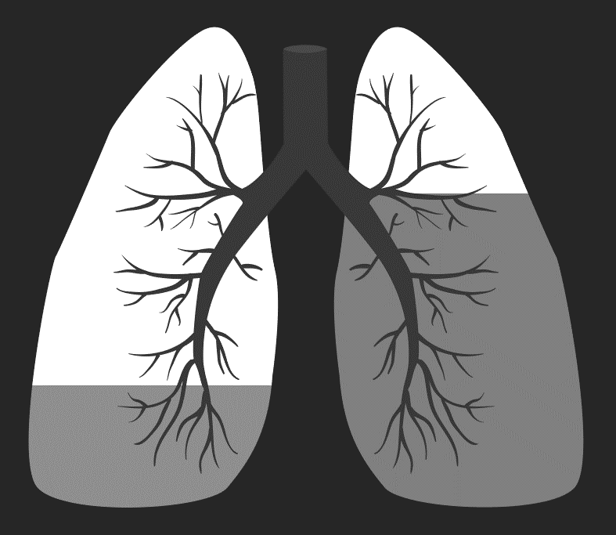

Lungs Cancer Detection System
Judith
5BIS - 31

Slide 2
Contents
Introduction
Objectives
Description of Datasets
Background Theorem
Workflow
Conclusion
References

Slide 3
Introduction
Lung cancer is the uncontrolled growth of abnormal cells in one or both lungs. These abnormal cells do not carry out the functions of normal lung cells and do not develop into healthy lung tissue.
Lung cancer often spreads to other parts of the body, such as the brain and the bones. Cancer that spreads can cause pain, nausea, headaches, or other signs and symptoms depending on what organ is affected. Once lung cancer has spread beyond the lungs, it's generally not curable.
The prediction work is divided into two phases, data preprocessing is done in the first phase, followed by a classification phase by machine learning.

Slide 4
Objectives
Early stage detection of cancer.
To increase the survivability of the patient.
To reduce the time and cost required for various excessive Medical Tests.
To increase the accuracy of performance of Lung Cancer Prediction and Detection System.

Slide 5
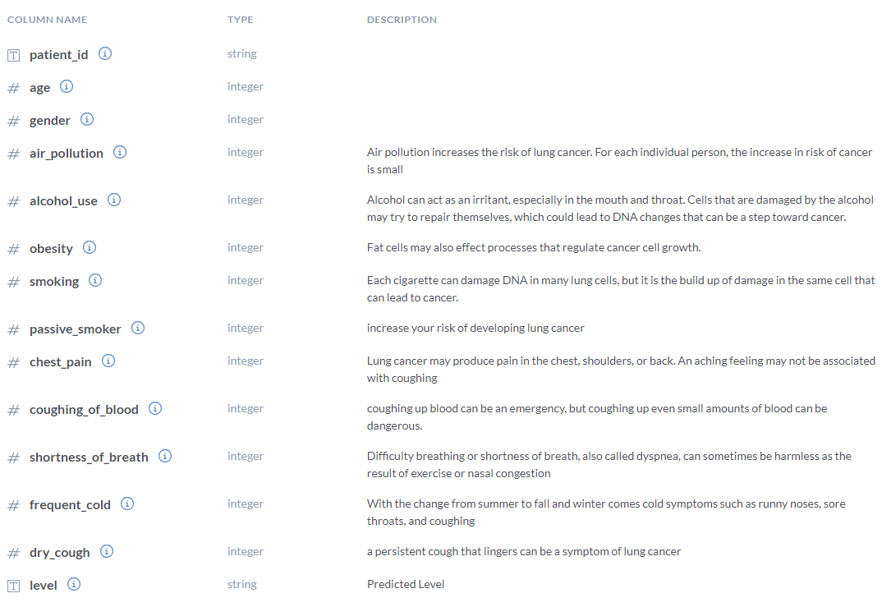
Description of Data set
Lungs Cancer Patients Data set
Total Number of Attributes : 14
Total Instances : 1000

Slide 6
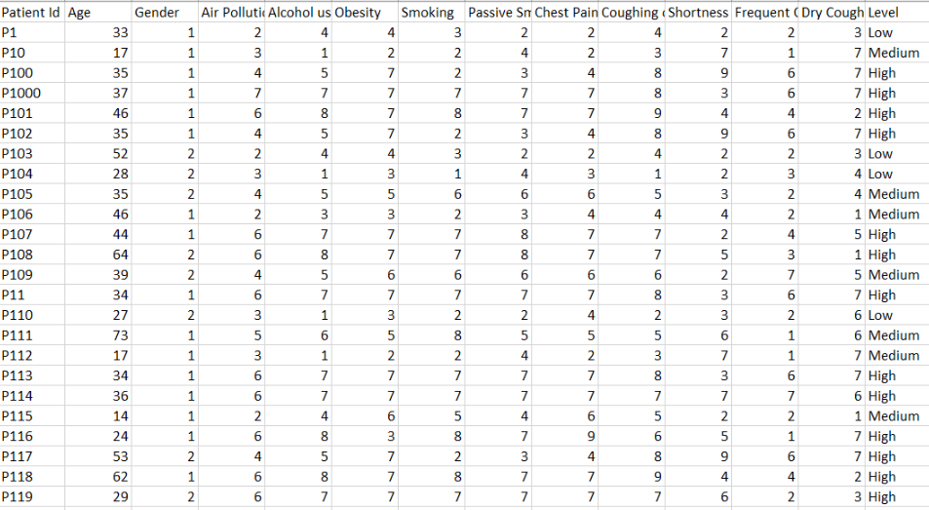
Data set Sample

Slide 7

K means Algorithm
K-means is the most important simple clustering algorithm.
Its objective is to minimize the average squared Euclidean distance

Slide 8
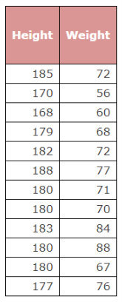
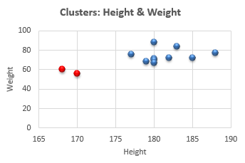
K means Example
Business Scenario:
We have height and weight information. Using these two variables, we need to group the objects based on height and weight information.
Data Sample

Slide 9
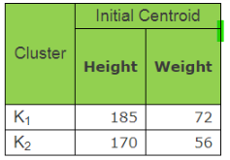
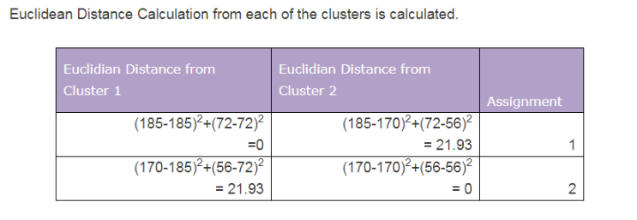
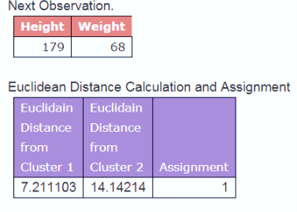
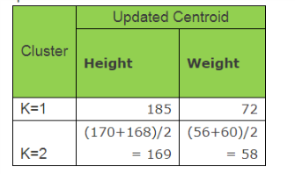
K means Example
Let K = 2,

Slide 10
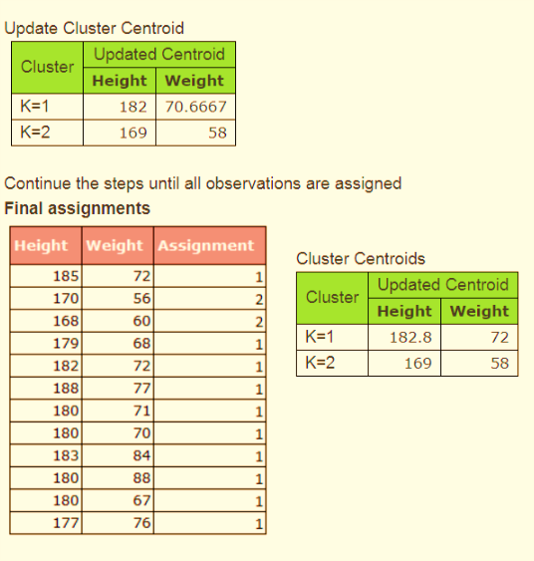
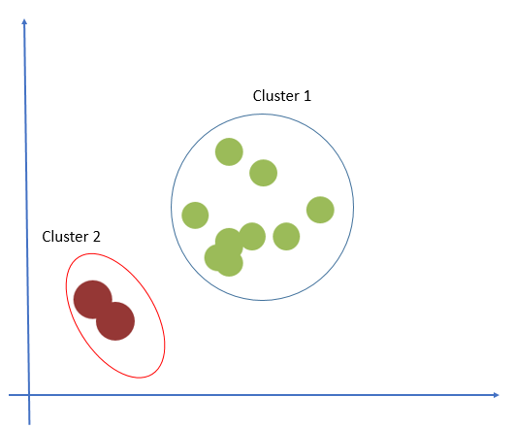
K means Example
This is what was expected initially based on two-dimensional plot.

Slide 11
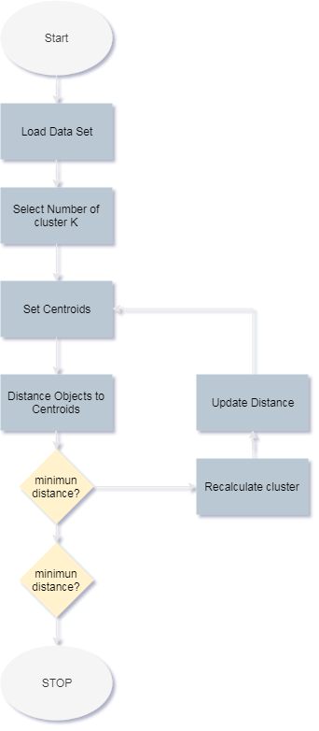
Overview of K-Means

Slide 12
Conclusion
This project gives an estimate prediction with stages about the detection of lungs cancer by applying the K-means algorithm.

Slide 13
References
https://www.researchgate.net/publication/280858442_Lung_Cancer_Data_Analysis_by_k-means_and_Farthest_First_Clustering_Algorithms
http://www.indjst.org/index.php/indjst/article/viewFile/73329/57005
http://ijirt.org/master/publishedpaper/IJIRT101678_PAPER.pdf
https://data.world/cancerdatahp/lung-cancer-data
https://data.world/linhtet98/lcdata
https://alpine.atlassian.net/wiki/spaces/V6/pages/108757278/K-Means+Output
http://dni-institute.in/blogs/k-means-clustering-algorithm-explained/

Slide 14

Thank you

